Slide 1
Unit - 4
Performing Basic Linux Tasks : Identify the linux design philosophy, Enter shell commands, get help with linux
Managing Users and Groups : Assume superuser privileges, Create, modify and delete users, Create, modify and delete groups, Query users and groups, Configure account profiles
Managing Permissions and Ownership : Modify file and directory permissions, Modify file and directory ownership, Configure special permissions and attributes, Troubleshoot permissions issues
Managing Storage : Create partitions, Manage logical volumes, Mount file systems, Manage file systems, Navigate the linux directory structure, Troubleshoot storage issues

Slide 2
Identify the linux design philosophy
The following quote from the section Introduction of the Unix philosophy of the book Linux and the Unix Philosophy, by Mike Gancarz, quite informative.
“An operating system, by its nature, embodies the philosophy of its creators. The creators of the Unix operating system started with a radical concept: they assumed that the user of their operating system would be computer literate from the start. The entire Unix philosophy revolves around the idea that the user knows what he or she is doing.”

Slide 3
Enter shell commands
A shell is a special user program that provides an interface to the user to use operating system services.
Shell accepts human-readable commands from the user and converts them into something which the kernel can understand.
It is a command language interpreter that executes commands read from input devices such as keyboards or from files.
The shell gets started when the user logs in or starts the terminal.

Slide 4

cd
Change directory

Slide 5

date
Displays current day date time

Slide 6

who
Displays current login user

Slide 7

touch
To create any file

Slide 8
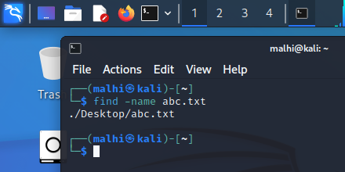
find
Find where the specific file is situated

Slide 9
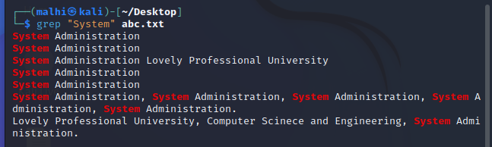
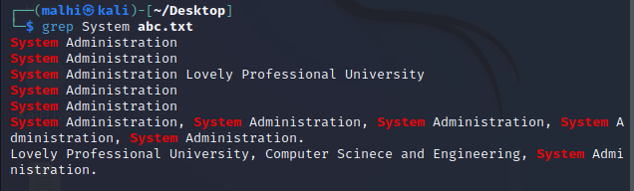
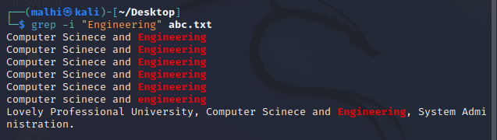
grep
Grep is an acronym that stands for Global Regular Expression Print.
The grep command searches through the file, looking for matches to the pattern specified.
Grep is case-sensitive.

Slide 10

ls
Displays files and folders present in the current directory

Slide 11


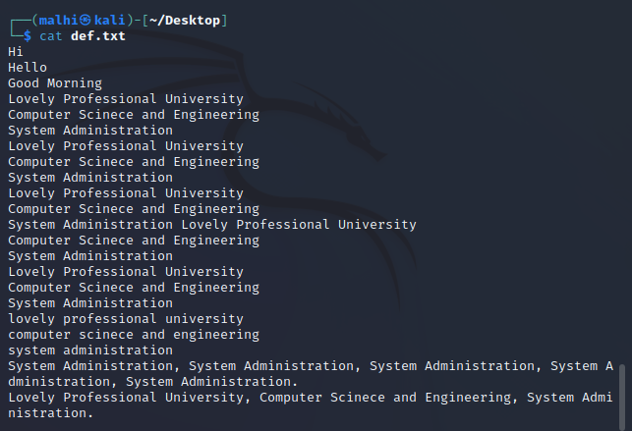
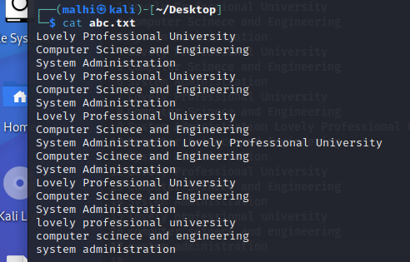
cat
Displays content of specific file
Copies content of one file into another file (after existing content of another file)

Slide 12

cp
Copies whole content of first file into another file (also creates another file if it is not available)

Slide 13

mkdir
It makes or creates the new directory

Slide 14

rm
It removes the specific file

Slide 15

pwd (print working directory)
It displays the path of working directory

Slide 16
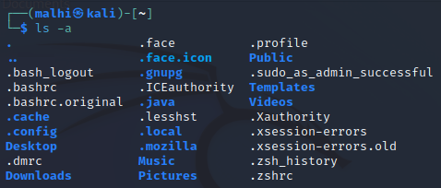
ls -a
It displays the hidden files and directories

Slide 17
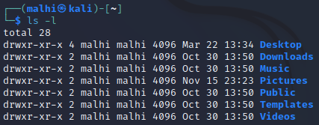
ls -l
It displays files and directories with permissions

Slide 18
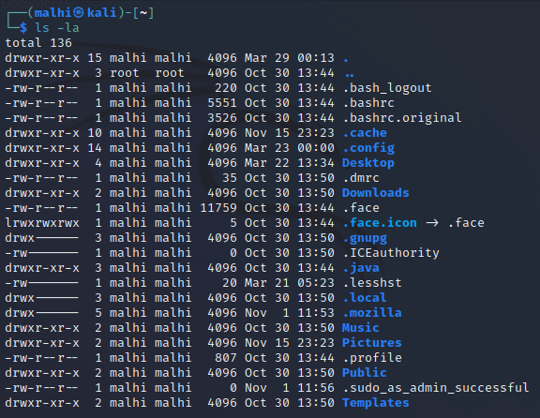
ls -la
It displays the hidden files
and directories with
permissions
The “ lrwxrwxrwx ” shows that the file is the symbolic link to another file, and it allows all the permissions, read, writes, and execution to all its users and groups.

Slide 19
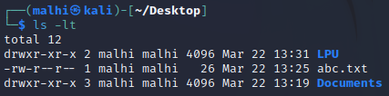
ls -lt
It displays the files according to their modified date. The files under the specific directory will be listed according to their modified date. And last modified file will be at the top.

Slide 20
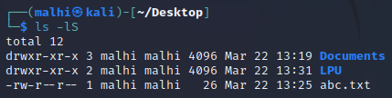
ls -lS
It displays content of specific directory in a descending order that is largest file at the top.

Slide 21

echo
It display the same message on the screen

Slide 22
File editing commands:
To install vim on Debian based Linux like ubuntu run the command:
sudo apt-get install vim

Slide 23
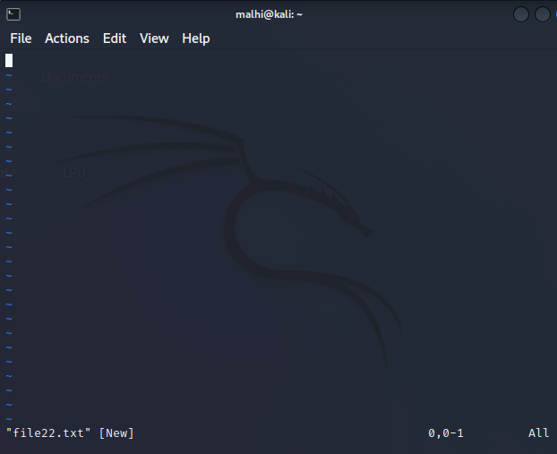

vim
Press i to enter into insert mode
Then write your content
After writing, exit from insert
mode by pressing escape key
To save write :wq

Slide 24
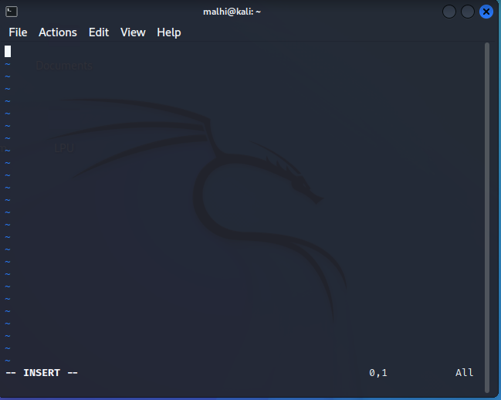
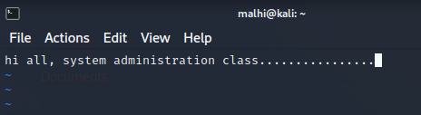


Slide 25

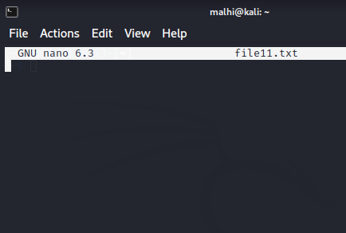
nano
nano

Slide 26
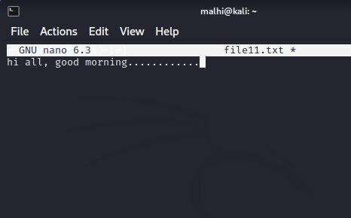

Ctrl + O to save
Ctrl + C to cancel the current
work
Ctrl + X to exit
Then press Y

Slide 27

Users and groups
To create an user

Slide 28

User creation with comment

Slide 29

User creation with user id

Slide 30

To set the password of an user

Slide 31
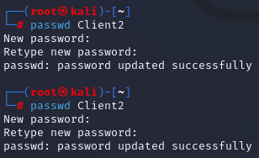
To reset the password of an user

Slide 32


To change the username

Slide 33

To set the user account expiration date

Slide 34

To delete an user

Slide 35
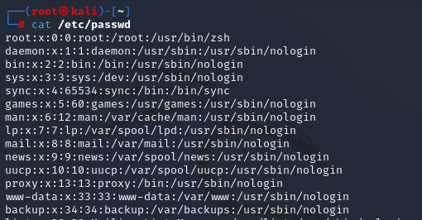
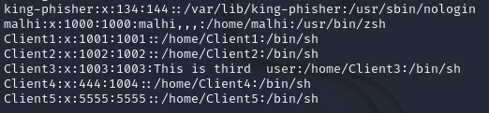
To check the all users

Slide 36

Create the group

Slide 37

To add user in the group

Slide 38

To create a group id

Slide 39

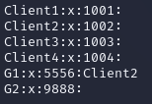
To change the group id

Slide 40

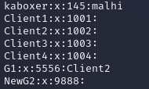
To change the group name (rename)

Slide 41

To delete any group. It does not delete user accounts that are members of the group.

Slide 42
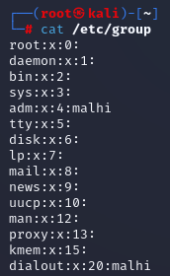
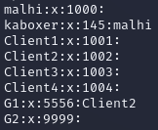
To display all the groups
along with users in
the groups

Slide 43
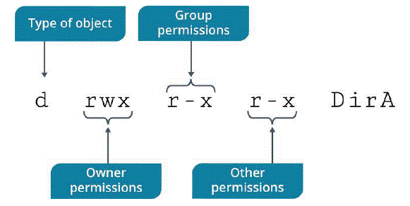
File Permissions
Every file has its own access rights for different groups of users.
Access rights are – Read, Write and Execute.
These rights are provided to different groups of users which are- Owner, Groups, Other Users.

Slide 44
A file’s permission appears to be in format of three group of letters.
Here three groups represent the permissions given to groups of the user.
Owner (u): The owner of the file or directory, also simply referred to as the user.
Group (g): The file or directory's group and all users belonging to that group.
Other (o): All other users (neither owner nor group member).

Slide 45
First part: Represents the access rights of the owner of the file.
Second part: Represents the access rights of group.
Third part: Represents the access rights of other users
Here, meaning of symbols is as following:
r- readable,
w- writeable and
x- executable

Slide 46
chmod command is used to change the permissions of files and directories.

Slide 47
7- We are granting all rights- reading, writing and executing a file
6- We are granting two rights- reading and writing on file.
5- We are granting two rights- read and execute file.
4- We are granting one right- read a file.
3- We are granting two rights – write and execute a file.
2- We are granting one right- write on a file.
1- We are granting one right- execute a file.
0- We are granting no rights at all.
For Example: chmod 750 F2.txt

Slide 48
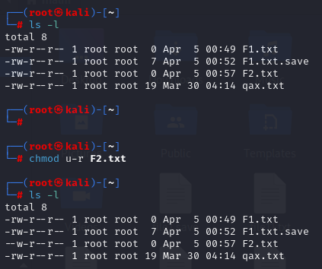

Slide 49
Suppose we want to allow write permissions to group:
chmod g+w F2.txt
Suppose we want to deny execute permissions to owner:
chmod u-x F2.txt

Slide 50
Create Partitions
The first task in managing storage is to partition a storage device and format the partition with a file system.

Slide 51
STORAGE DEVICES
A storage device is a physical component that can record data and hold it persistently.
There are many types of storage devices that are supported by the Linux operating system.

Slide 52
Hard disk drive (HDD)—electromechanical devices that use magnetic storage technology to store data, usually in large amounts.
Solid-state drive (SSD)—storage devices that use non-mechanical solid-state technology to store data, usually in large amounts. They tend to support much quicker access times than HDDs.
USB thumb drive—portable storage devices that use flash memory technology to store data, usually in small amounts compared to HDDs and SSDs. Their small size makes them easy to move around.
External storage drive—portable storage drives that can use one of several technology types. They usually connect to a computer through a peripheral interface like USB, rather than being an internal component

Slide 53
BLOCK VS. CHARACTER DEVICES
Linux refers to devices as either block or character devices.
Block devices are storage devices (like those listed previously) that can be read from and written to in blocks of data. (random access(buffering))
Character devices are devices like keyboards, mice, serial ports, etc., that can be read from and written to in streams of data. (sequential access(no buffering))

Slide 54
FILE SYSTEMS
A file system is a data structure that is used by an operating system to store, retrieve, organize, and manage files and directories on storage devices.
A file system maintains information such as the date of creation and modification of individual files, the size of files on the storage device, the type of files, and permissions associated with files.
It also provides a structured form for data storage.

Slide 55
Linux supports many file system types. The most common are described in the following table.
FAT: File Allocation Table (FAT) is an older file system that is compatible with many different operating systems, including all versions of Unix, Windows, and macOS.
Improved versions include FAT32 and exFAT.

Slide 56
ext2 (second extended file system): This used to be the native Linux file system of some older releases.
It is still supported in current releases of Linux

Slide 57
ext3: This is an improved version of ext2.
In case of an abrupt system shutdown, ext3 is much faster in recovering data and better ensures data integrity.
It can be easy to upgrade the file system from ext2 to ext3.

Slide 58
ext4: This is one of two default file system for Linux distributions.
It is backwards-compatible with the ext2 and ext3 file systems.
Among ext4's improvements over ext3 are journaling, support of volumes of up to one exbibyte (EiB), and files up to 16 tebibyte (TiB) in size.
This is the default file system for Ubuntu installations.
(journaling: keeps track of changes in a log before committing the changes to the main file system.)

Slide 59
XFS(Extents File System): This is a 64-bit, high-performance journaling file system that provides fast recovery and can handle large files efficiently.

Slide 60
NETWORK FILE SYSTEMS
While the previous table lists general-purpose file systems, some file systems function as network protocols that enable the sharing of data over a network.
Common types include the following:
Server Message Block: The SMB protocol provides users shared access to files and other resources across a local area network (LAN). SMB clients make requests for resources to SMB servers, which respond and provide the appropriate level of access. This protocol is primarily used with Windows computers.

Slide 61
Common internet file system (CIFS) is a specific implementation of SMB that is rarely in use.
Microsoft designed it as a successor to SMB version 1, but SMB versions 2 and 3 superseded it.

Slide 62
Network File System (NFS) offers similar functionality to SMB, but the protocols are not compatible.
NFS is preferred in situations where Linux clients access Linux servers.
In environments that are a mix of Windows and Linux.

Slide 63
INODES
An index node (inode) is an object that stores metadata about a file or directory on a file system.
This metadata can include time-based values like when a file was created and last modified; permission and ownership information; the block locations of a file’s data on a storage device; and other miscellaneous information.

Slide 64
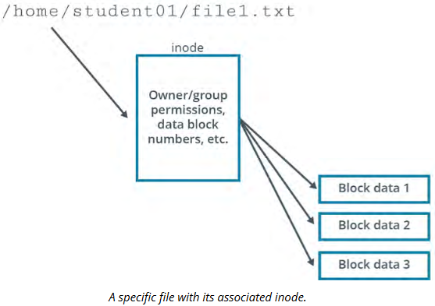

Slide 65
Each inode on a file system is identified by a unique integer called an inode number.
Whenever the system or an application tries to access a file, it searches for the appropriate inode number in a data structure called an inode table.
The inode table maps an inode number to its corresponding file or directory name.

Slide 66
JOURNALING
It is a method by which a file system records changes that have not yet been made to the file system itself in an object called a journal.
This enables the file system to quickly recover after an unexpected interruption, such as a system crash, because the system can reference pending changes in the journal to resume where it had left off.

Slide 67
The journaling process involves the following phases:
1. The journal describes all the changes that must be made to the drive.
2. A background process makes each change as and when it is entered in the journal.
3. If the system shuts down, pending changes are performed when it is rebooted.
4. Incomplete entries in the journal are discarded.

Slide 68
VIRTUAL FILE SYSTEM
A real file system refers to a discrete file system that the Linux kernel can normally work with directly.
The problem is, Linux supports many different file system types that aren't necessarily compatible.
The virtual file system (VFS) was created as a common software interface that sits between the kernel and real file systems.
In effect, the VFS translates a real file system's details to the kernel so that the file system appears identical to any other file system.

Slide 69
With VFS, you can mount multiple different types of file systems on the same Linux installation, and they will appear uniform to the user and to all other applications.
Therefore, the user and these applications can work with the file system without actually knowing its underlying structure.
This greatly increases interoperability between the system and running software.

Slide 70
Examples of real file systems on a Linux system can include xfs, ext4, and several other types.
Examples of virtual file systems can include proc, which contains system information during runtime; devtmpfs, which contains device nodes loaded by the kernel during system initialization; debugfs, which contains information useful in debugging the Linux kernel; and many more.

Slide 71
PARTITIONS
A partition is a section of the storage drive that logically acts as a separate drive.
Partitions enable you to convert a large drive to smaller manageable chunks, leading to better organization of information.
A partition must be formatted and assigned a file system before data can be stored on it.
Partitions are identified using a partition table, which is stored in one or more areas of the drive.
The size of each partition can vary but cannot exceed the total free space of the storage drive.

Slide 72
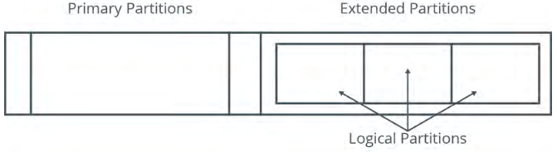
TYPES OF PARTITIONS
There are three types of partitions: primary, extended, and logical.

Slide 73
PRIMARY: A partition that can contain one file system or logical drive and is sometimes referred to as a volume. The swap file system and the boot partition are normally created in a primary partition.
Extended: An extended partition can contain several file systems, which are referred to as logical drives. There can be only one extended partition, which can be further subdivided. This partition type does not contain any data and has a separate partition table.

Slide 74
Logical: A part of a physical drive that has been partitioned and allocated as an independent unit and functions as a separate drive. A logical partition is created within an extended partition, and is therefore a subset of an extended partition. There is no restriction on the number of logical partitions, but it is advisable to limit it to 12 logical partitions per drive.

Slide 75
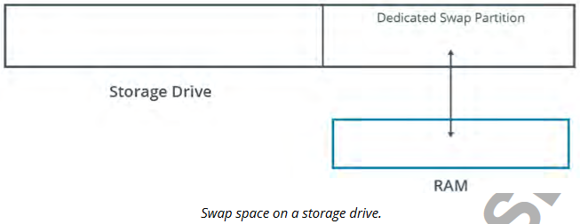
SWAP SPACE
It is a partition on the storage device that is used when the system runs out of physical memory.
Linux pushes some of the unused files from RAM to the swap space to free up memory. Usually, the swap space equals twice the RAM capacity.

Slide 76
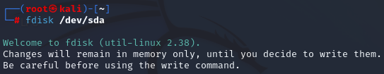
THE fdisk UTILITY
The fdisk utility is a menu-driven program that is used to create, modify, or delete partitions on a storage drive.
sda is a storage device

Slide 77
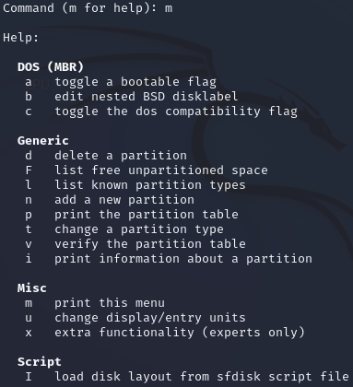
m for help

Slide 78
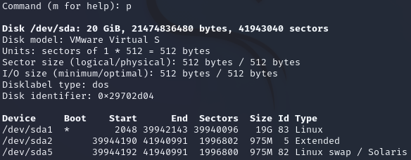
p is print partitions

Slide 79
GNU PARTED
The GNU Parted utility is also used to manage partitions.
It is particularly useful when creating partitions on new storage drives.
It can be used to create, destroy, and resize partitions.

Slide 80
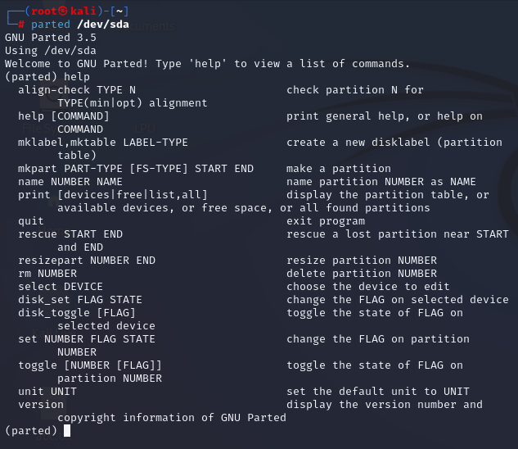

Slide 81
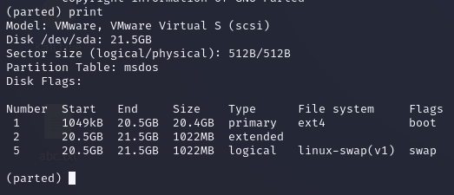

Slide 82
THE partprobe COMMAND
The partprobe command is used to update the kernel with changes in the partition table.
The command first checks the partition table, and if there are any changes, it automatically updates the kernel with the changes.

Slide 83
After creating a partition with fdisk, you cannot add a file system to that partition unless the kernel can read it from the partition table.
You might receive an error like "Re-reading the partition table failed" during the fdisk operation.
Rebooting the machine updates the table, or you can issue partprobe instead to update the table without a reboot.

Slide 84
THE mkfs COMMAND
The mkfs command is used to build a Linux file system on a device, which is usually a drive partition.

Slide 85
THE fstab FILE
The fstab file is a configuration file that stores information about storage devices and partitions and where and how the partitions should be mounted.
The fstab file is located in the /etc directory. It is read by the system at boot time and can be edited only by a root user.

Slide 86
THE crypttab FILE
The /etc/crypttab file performs a similar function to the fstab file, but its purpose is to store information about encrypted devices and partitions that must be unlocked and mounted on system boot.

Slide 87
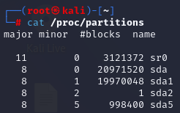
THE /proc/partitions FILE
The /proc/partitions file contains information about each partition that is currently attached to the system.

Slide 88
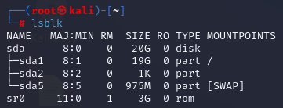
THE lsblk COMMAND
The lsblk command displays information about all block storage devices that are currently available on the system.

Slide 89
ADDITIONAL READING IS STRONGLY RECOMMENDED

